Slide 1
Budget Sales Analytics
By Anwesha Baidya : UMIP13240

Slide 2
Introduction
The "Domain Sale" process simplifies domain purchases, enabling buyers to buy domains directly from Marketplace at listed prices, without contacting sellers.
This analysis delves into a comprehensive dataset on domain sales and budgets, aiming to predict trends and extract actionable insights. Our goal is to enhance understanding of sales performance, budget allocation, and variance, facilitating better decision-making.

Slide 3
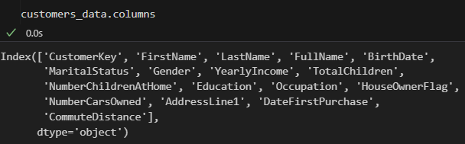
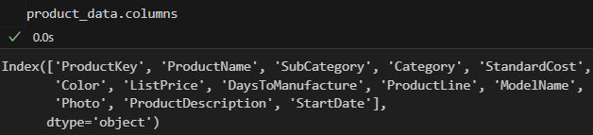
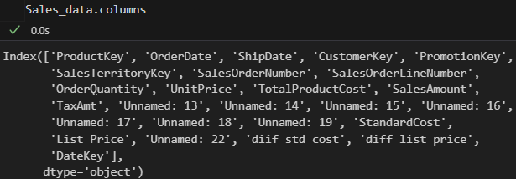
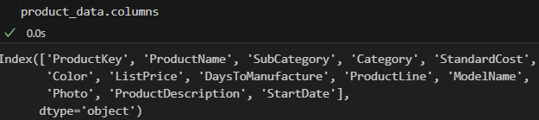

Details of Data
The data contains the various information such as Sales, budget, and variance.
This is the layout of data:

Slide 4
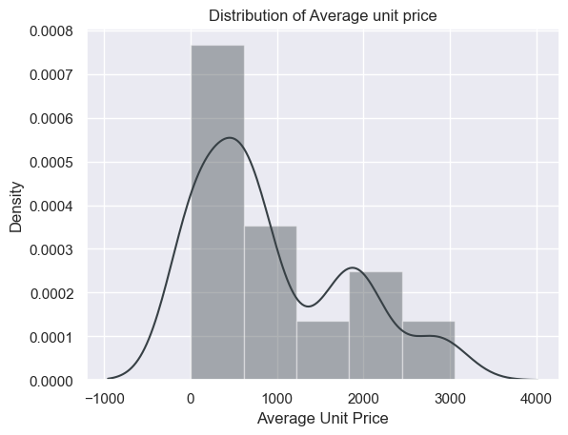
Unit Price analysis
SALES ORDER NUMBER DISTIBUTION:
36.97% of customers ordered more than once.

Slide 5
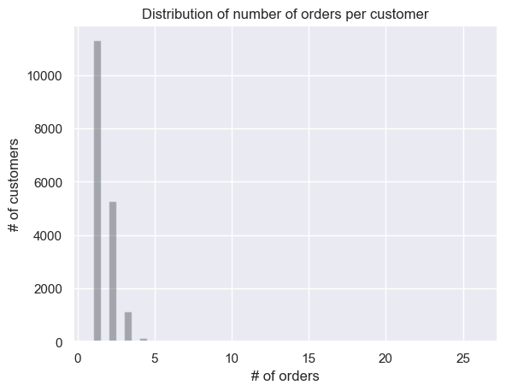
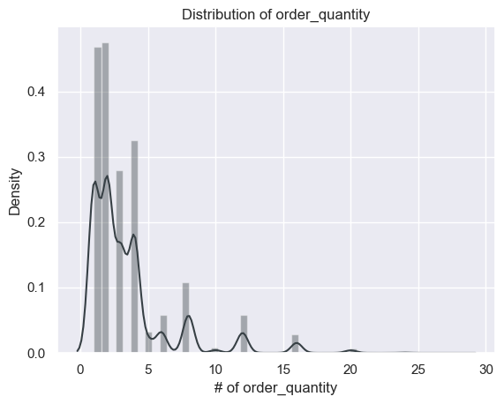
Orders per customer and quantity distribution

Slide 6
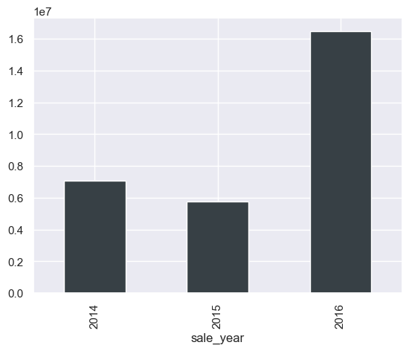
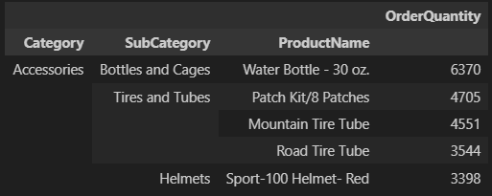
Year wise Sales Distribution and Top 5 selling product
Top 5 selling product
2016 has highest sales

Slide 7
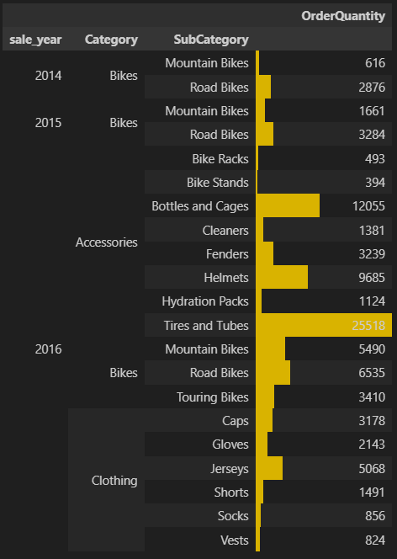
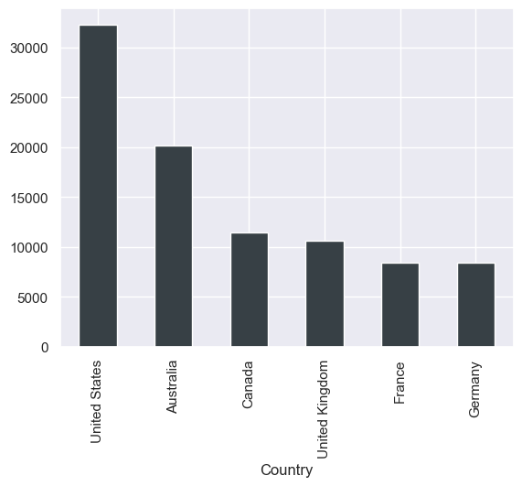
Quantity ordered based on category and subcategory
Country with highest orders.

Slide 8
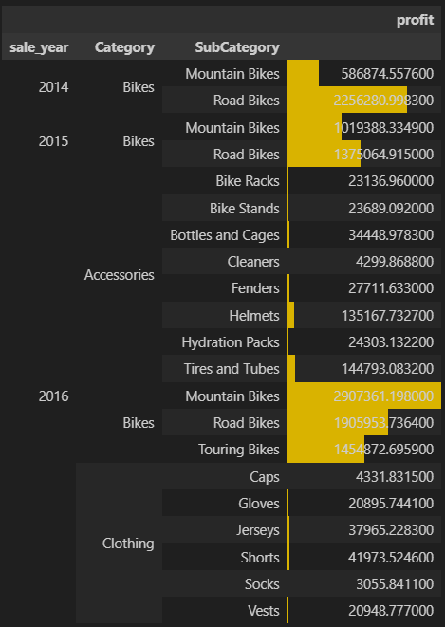
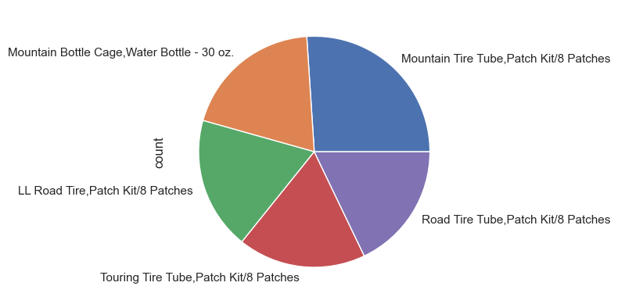
Profits

Slide 9
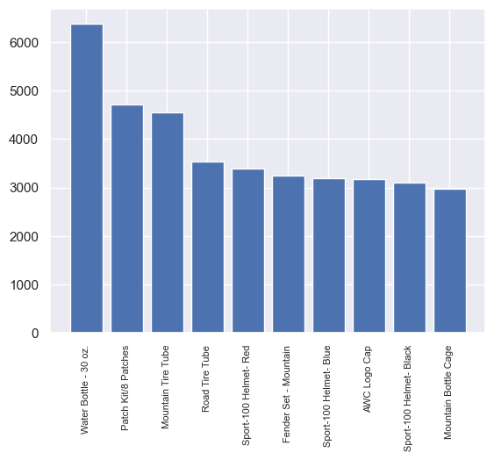
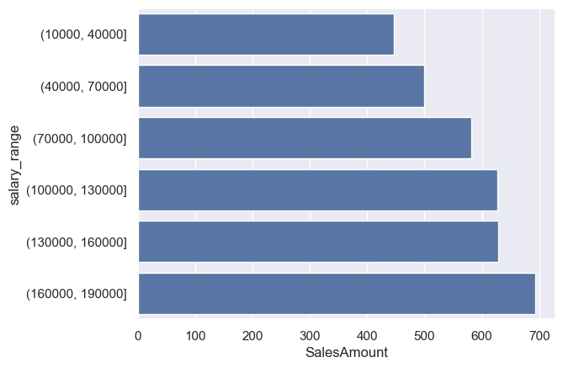
Highest sold product and Salary for sales

Slide 10
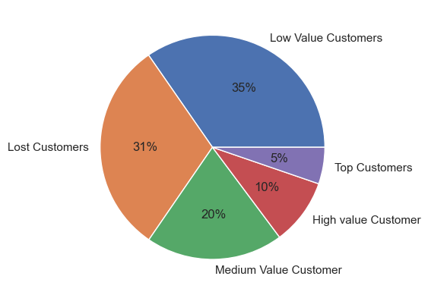
Customer Segmentation Results

Slide 11
Thank you

